Slide 1

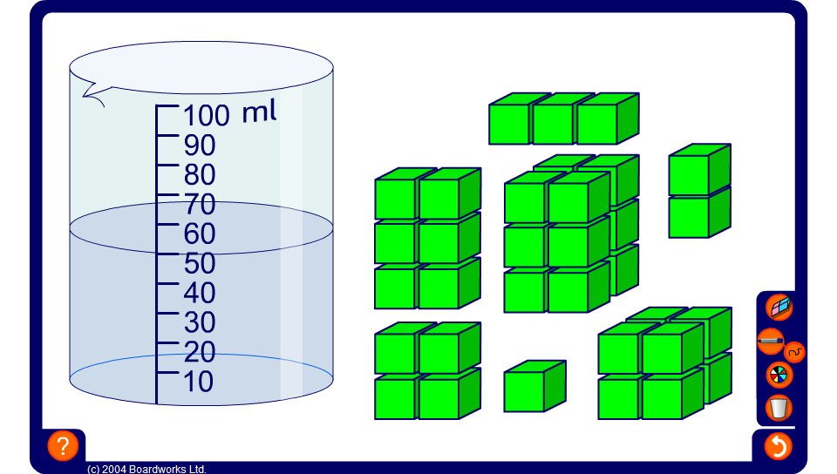


Volume and capacity
Notes:
Use this activity to demonstrate that we can find the volume of the cuboids by observing the change in the height of the water in the beaker. Each centimetre cube displaces 1 ml of water.

